Slide 1

Bayesian Classification and Regression
Module 3 Live Session (6/08/2021)
DS6040 Summer 2021
Teague R. Henry

Slide 2

Project Proposals Due 6/18
A 1-1.5 page description of your project
Whose in the group?
What data are you thinking of working with?
What question do you want to ask?
Some thoughts on possible approaches
If you don’t know the Bayesian approach off the top of your head, propose something you do know, and we can work together to determine an appropriate Bayesian method.

Slide 3
Outline
Prior Review
Evaluating Posterior Distributions
Linear Classification
Linear Discriminant Analysis
Quadratic Discriminant Analysis
Linear Regression

Slide 4
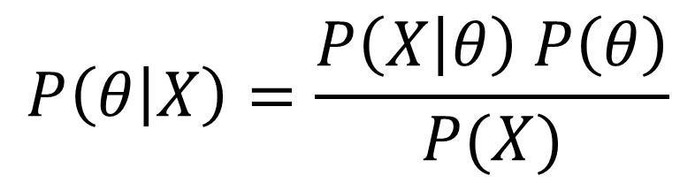
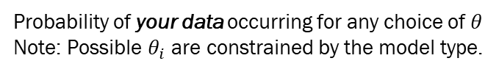
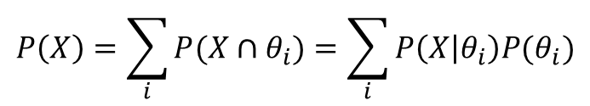
Where Do You Get These Pieces?
Likelihood
This comes from how you want to model the data (i.e. what distribution or distributions are the data from?)
Posterior Distribution
What is the distribution of the parameters of interest given the data
$$P\left(θ | X\right)=\frac{P\left(X | θ\right) P\left(θ\right)}{P(X)}$$
Prior Distribution
You come up with this (or it is clearly given to you)
$$P\left(X\right)=\sum_{i}{P(X∩θ_{i})}=\sum_{i}{P\left(X | θ_{i}\right)P(θ_{i})}$$
Marginal Distribution
You either calculate it in very simple cases, or it has already been taken care of (i.e. conjugate priors)
Probability of your data occurring for any choice of $θ$
Note: Possible $θ_{i}$ are constrained by the model type.

Slide 5
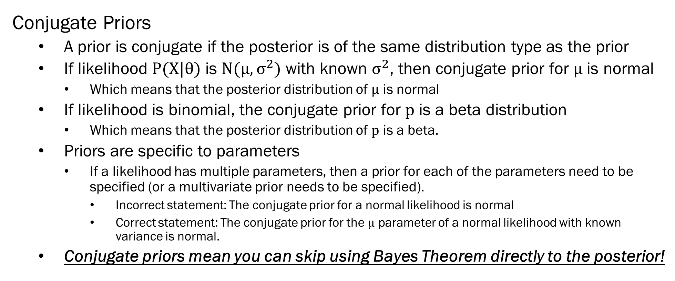
Prior Review
Conjugate Priors
A prior is conjugate if the posterior is of the same distribution type as the prior
If likelihood $P(X|θ)$ is $N(μ, σ^{2})$ with known $σ^{2}$, then conjugate prior for $μ$ is normal
Which means that the posterior distribution of $μ$ is normal
If likelihood is binomial, the conjugate prior for $p$ is a beta distribution
Which means that the posterior distribution of $p$ is a beta.
Priors are specific to parameters
If a likelihood has multiple parameters, then a prior for each of the parameters need to be specified (or a multivariate prior needs to be specified).
Incorrect statement: The conjugate prior for a normal likelihood is normal
Correct statement: The conjugate prior for the $μ$ parameter of a normal likelihood with known variance is normal.
Conjugate priors mean you can skip using Bayes Theorem directly to the posterior!

Slide 6
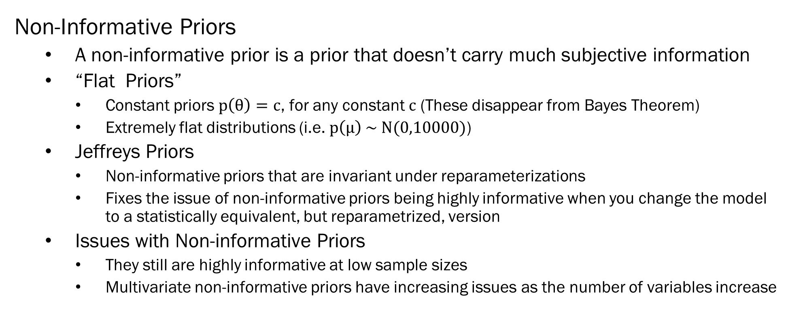
Prior Review
Non-Informative Priors
A non-informative prior is a prior that doesn’t carry much subjective information
“Flat Priors”
Constant priors $p\left(θ\right)=c$, for any constant $c$ (These disappear from Bayes Theorem)
Extremely flat distributions (i.e. $p\left(μ\right) \sim N(0,10000)$)
Jeffreys Priors
Non-informative priors that are invariant under reparameterizations
Fixes the issue of non-informative priors being highly informative when you change the model to a statistically equivalent, but reparametrized, version
Issues with Non-informative Priors
They still are highly informative at low sample sizes
Multivariate non-informative priors have increasing issues as the number of variables increase

Slide 7
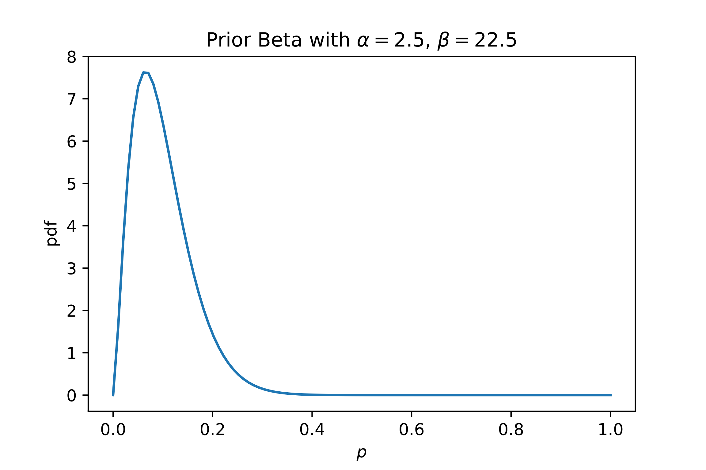
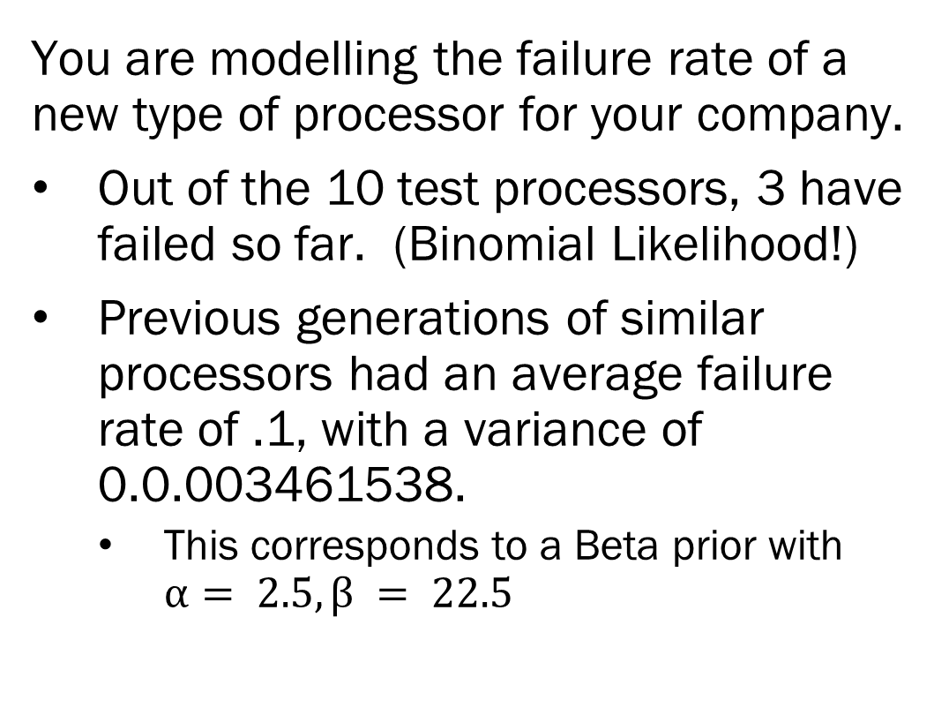
Evaluating Posterior Distributions
You are modelling the failure rate of a new type of processor for your company.
Out of the 10 test processors, 3 have failed so far. (Binomial Likelihood!)
Previous generations of similar processors had an average failure rate of .1, with a variance of 0.0.003461538.
This corresponds to a Beta prior with $α= 2.5, β = 22.5$

Slide 8
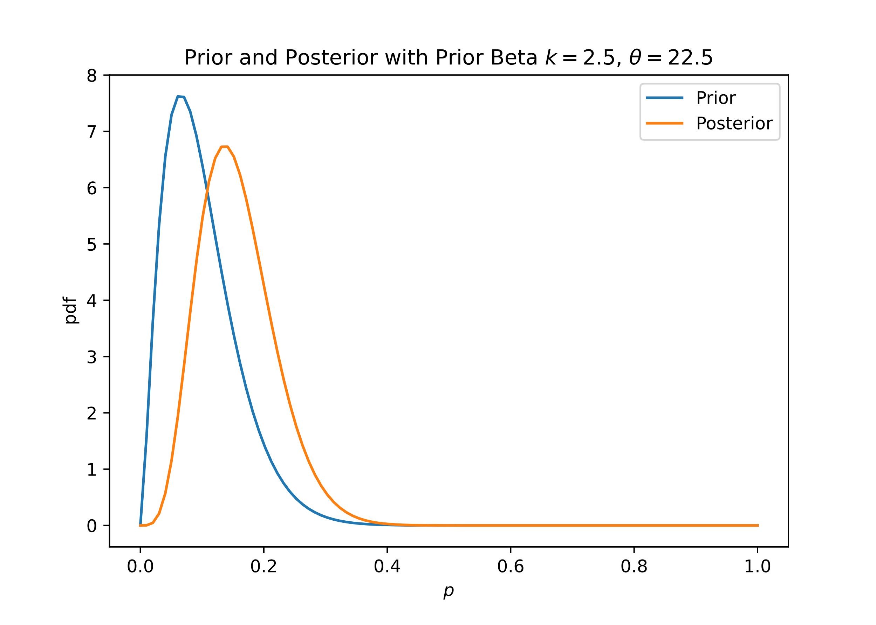
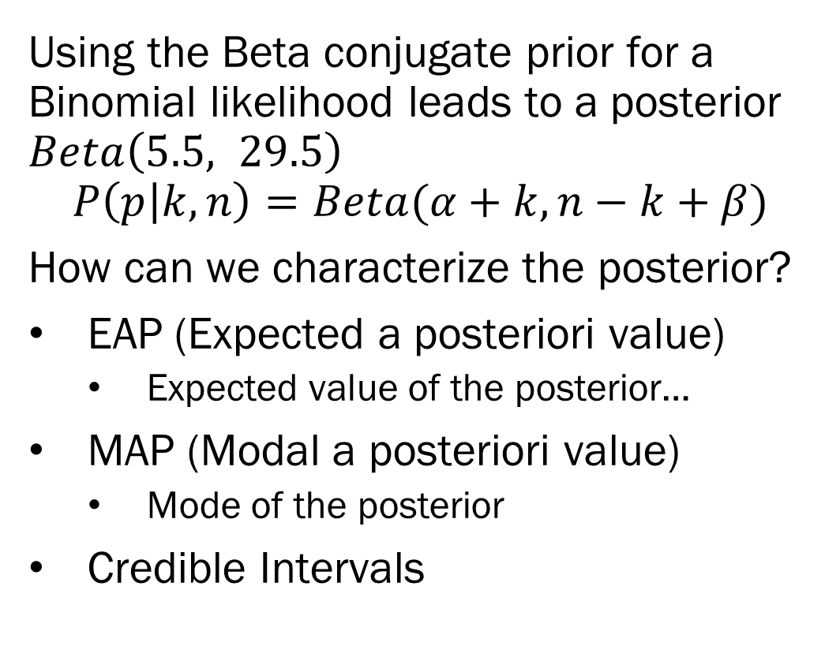
Evaluating Posterior Distributions
Using the Beta conjugate prior for a Binomial likelihood leads to a posterior $Beta\left(5.5, 29.5\right)$
$$P\left(p | k,n\right)=Beta(α+k, n−k+β)$$
How can we characterize the posterior?
EAP (Expected a posteriori value)
Expected value of the posterior…
MAP (Modal a posteriori value)
Mode of the posterior
Credible Intervals

Slide 9
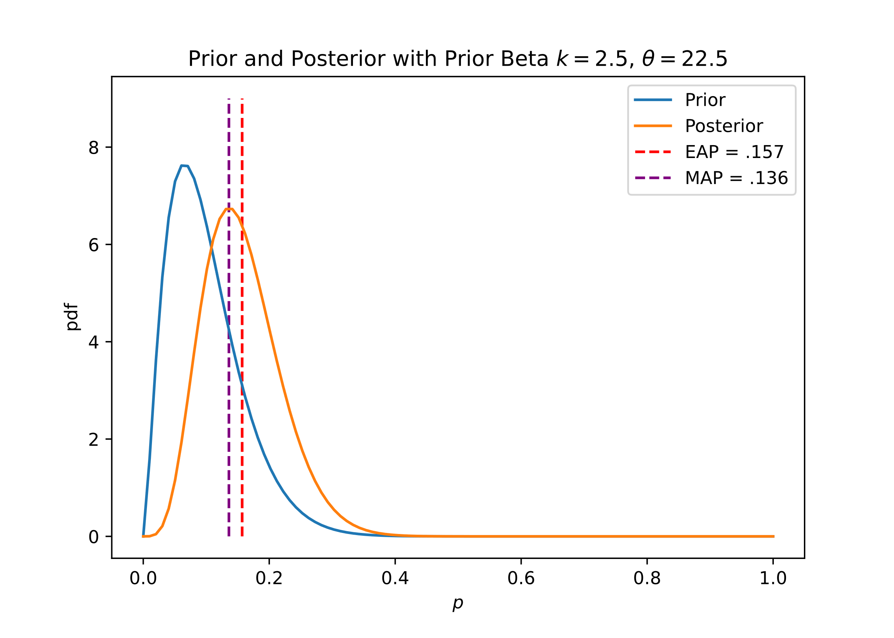
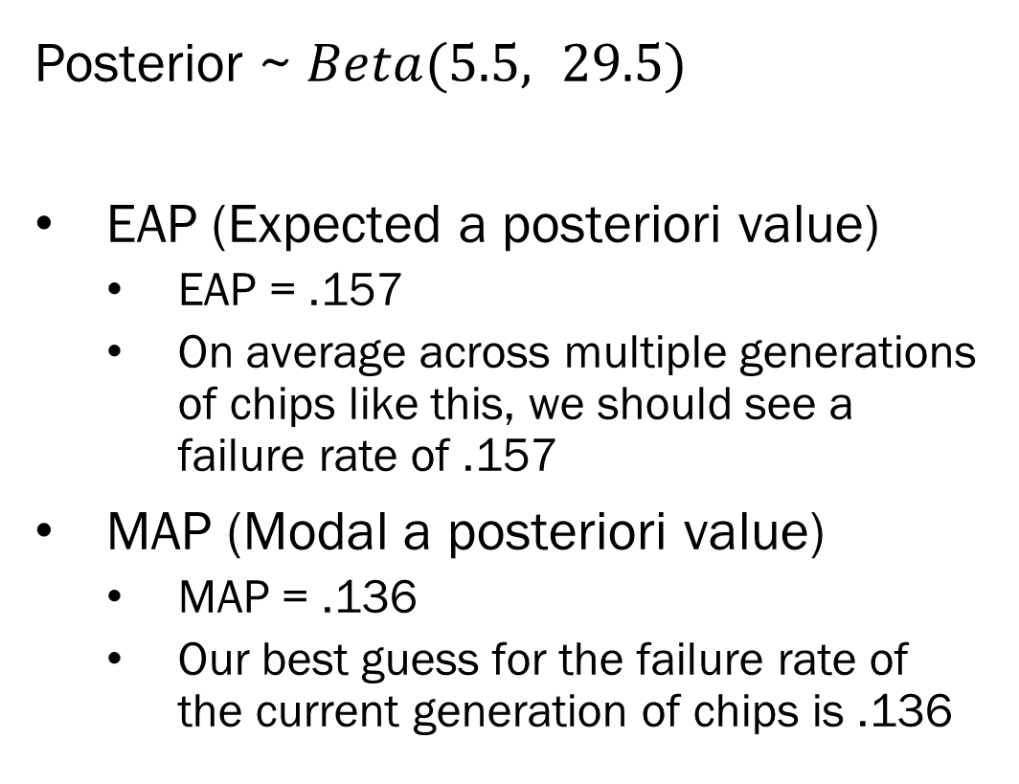
Evaluating Posterior Distributions
Posterior ~ $Beta(5.5, 29.5)$
EAP (Expected a posteriori value)
EAP = .157
On average across multiple generations of chips like this, we should see a failure rate of .157
MAP (Modal a posteriori value)
MAP = .136
Our best guess for the failure rate of the current generation of chips is .136

Slide 10
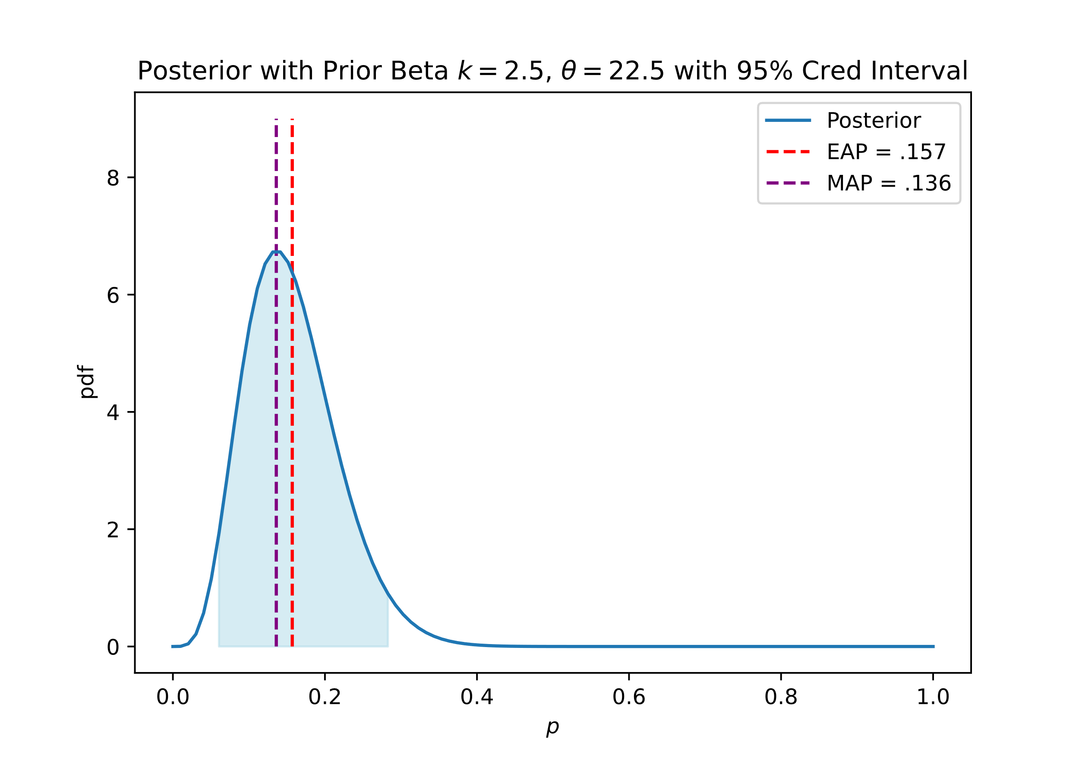
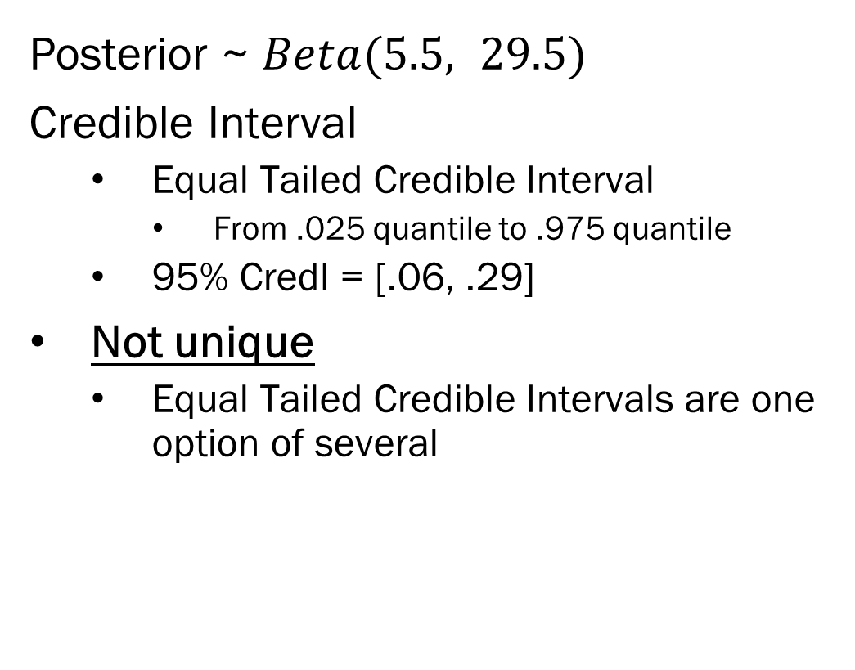
Evaluating Posterior Distributions
Posterior ~ $Beta(5.5, 29.5)$
Credible Interval
Equal Tailed Credible Interval
From .025 quantile to .975 quantile
95% CredI = [.06, .29]
Not unique
Equal Tailed Credible Intervals are one option of several

Slide 11
Bayesian Classification
Supervised Classification –
Given data that has discrete class labels, how can we best label new observations?
Unsupervised Classification –
Given data without discrete class labels, can we cluster them into meaningful groups?
Today we are focusing on supervised classification.

Slide 12
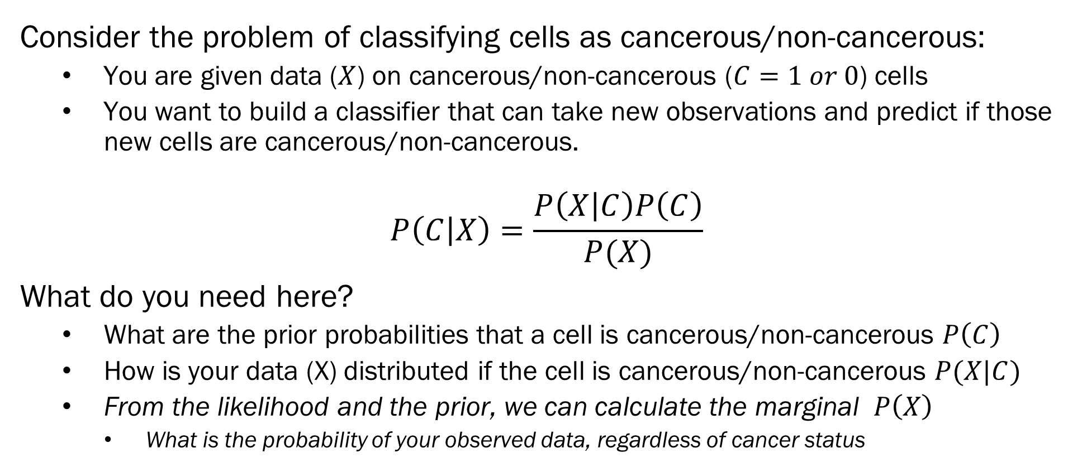
Bayes Optimal Classifiers
Consider the problem of classifying cells as cancerous/non-cancerous:
You are given data ($X$) on cancerous/non-cancerous ($C=1 or 0$) cells
You want to build a classifier that can take new observations and predict if those new cells are cancerous/non-cancerous.
$$P\left(C | X\right)=\frac{P\left(X | C\right)P\left(C\right)}{P(X)}$$
What do you need here?
What are the prior probabilities that a cell is cancerous/non-cancerous $P\left(C\right)$
How is your data (X) distributed if the cell is cancerous/non-cancerous $P(X|C)$
From the likelihood and the prior, we can calculate the marginal $P\left(X\right)$
What is the probability of your observed data, regardless of cancer status

Slide 13
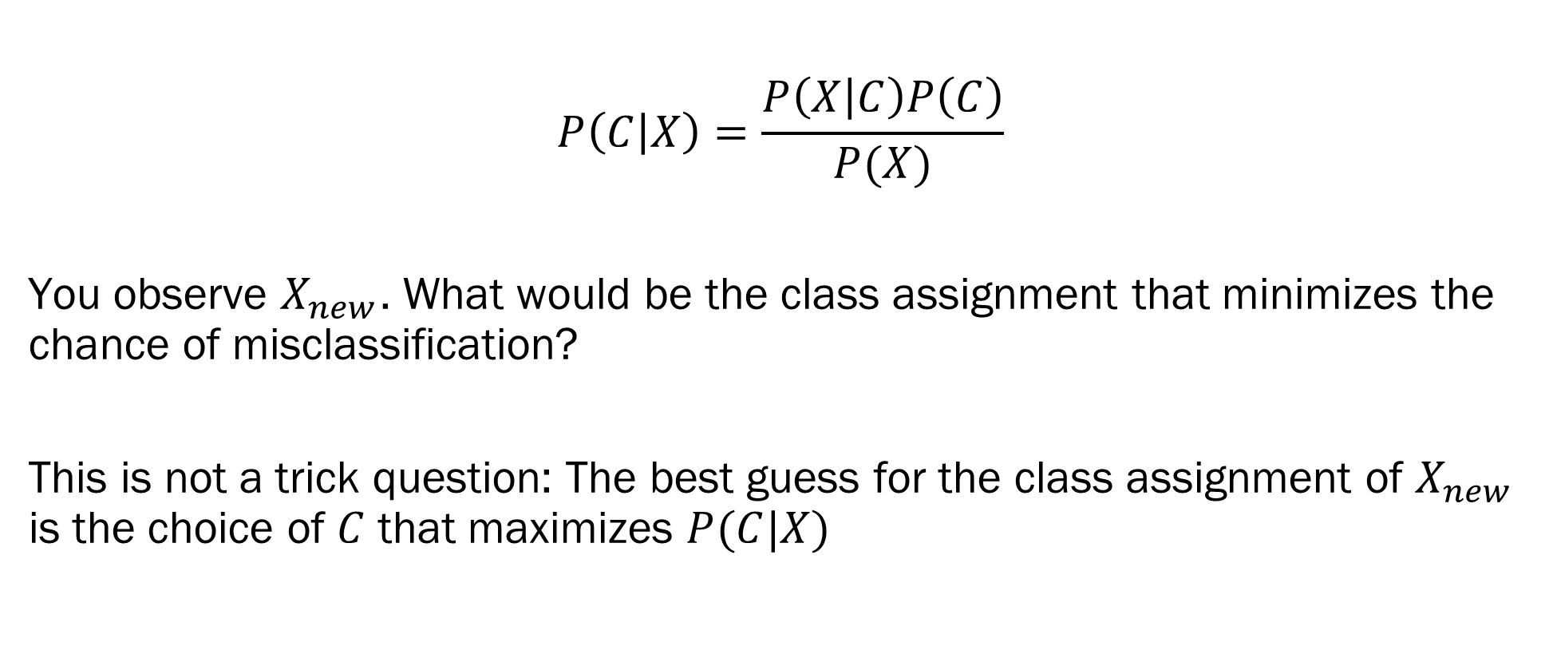
Bayes Optimal Classifiers
$$P\left(C | X\right)=\frac{P\left(X | C\right)P\left(C\right)}{P(X)}$$
You observe $X_{new}$. What would be the class assignment that minimizes the chance of misclassification?
This is not a trick question: The best guess for the class assignment of $X_{new}$ is the choice of $C$ that maximizes $P(C|X)$

Slide 14
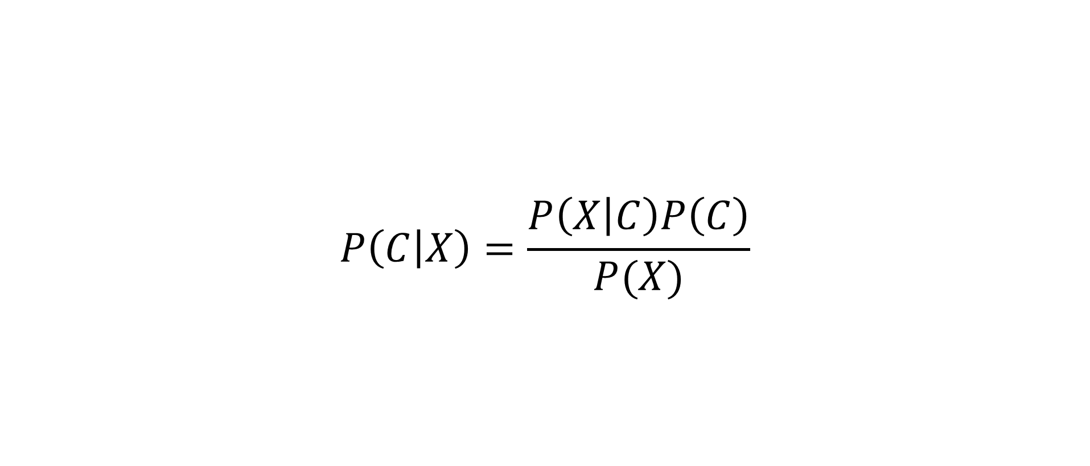
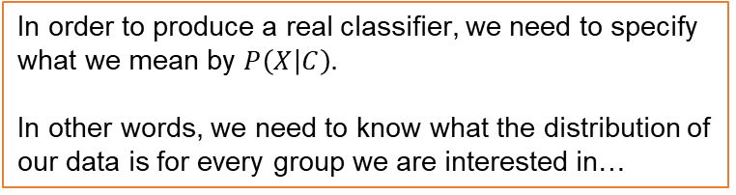
Bayes Optimal Classifiers
$$P\left(C | X\right)=\frac{P\left(X | C\right)P\left(C\right)}{P(X)}$$
In order to produce a real classifier, we need to specify what we mean by $P\left(X | C\right).$
In other words, we need to know what the distribution of our data is for every group we are interested in…
We want a classification rule that can give us the probability of group membership given our data…
Use of Bayes is appropriate here, but…
We also need to specify priors for our group membership
This will be fairly easy to calculate when we are working with classifiers

Slide 15
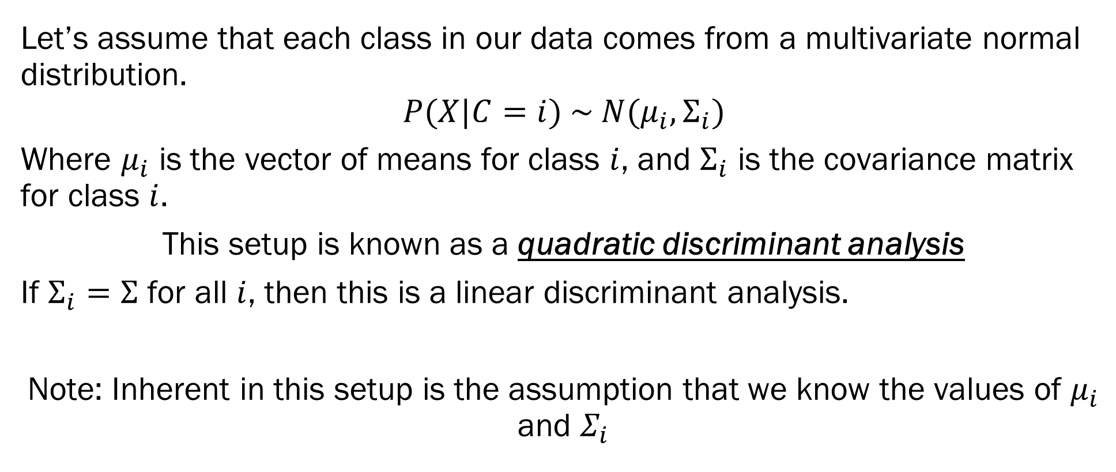
Quadratic/Linear Discriminant Analysis
Let’s assume that each class in our data comes from a multivariate normal distribution.
$$P(X|C=i) \sim N(μ_{i},Σ_{i})$$
Where $μ_{i}$ is the vector of means for class $i$, and $Σ_{i}$ is the covariance matrix for class $i$.
This setup is known as a quadratic discriminant analysis
If $Σ_{i}=Σ$ for all $i$, then this is a linear discriminant analysis.
Note: Inherent in this setup is the assumption that we know the values of $μ_{i}$ and $Σ_{i}$
Likelihood!

Slide 16
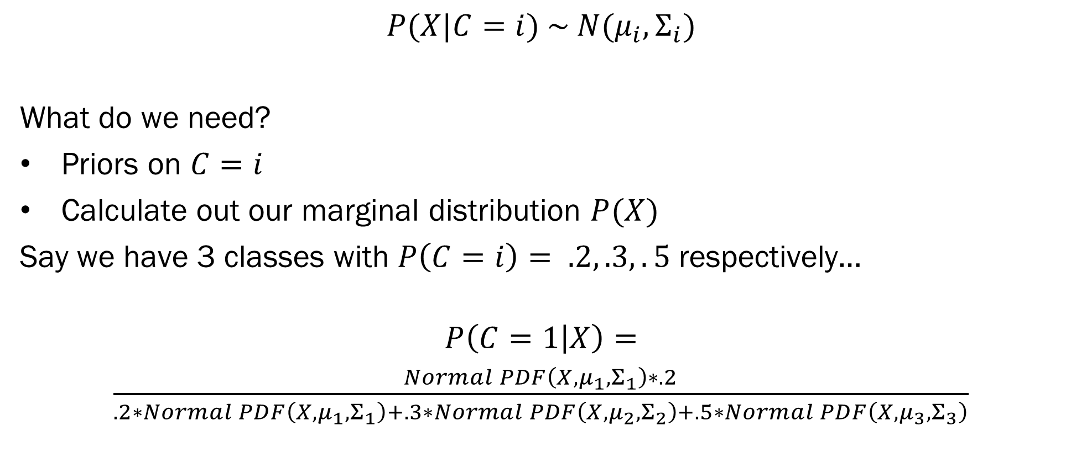
Quadratic/Linear Discriminant Analysis
$$P(X|C=i) \sim N(μ_{i},Σ_{i})$$
What do we need?
Priors on $C=i$
Calculate out our marginal distribution $P(X)$
Say we have 3 classes with $P\left(C=i\right)= .2, .3,.5$ respectively…
$$P\left(C=1 | X\right)=$$
$\frac{Normal PDF\left(X, μ_{1}, Σ_{1}\right)∗.2}{.2∗Normal PDF\left(X, μ_{1}, Σ_{1}\right)+.3∗Normal PDF\left(X, μ_{2}, Σ_{2}\right)+.5∗Normal PDF\left(X, μ_{3}, Σ_{3}\right)}$
Likelihood!

Slide 17
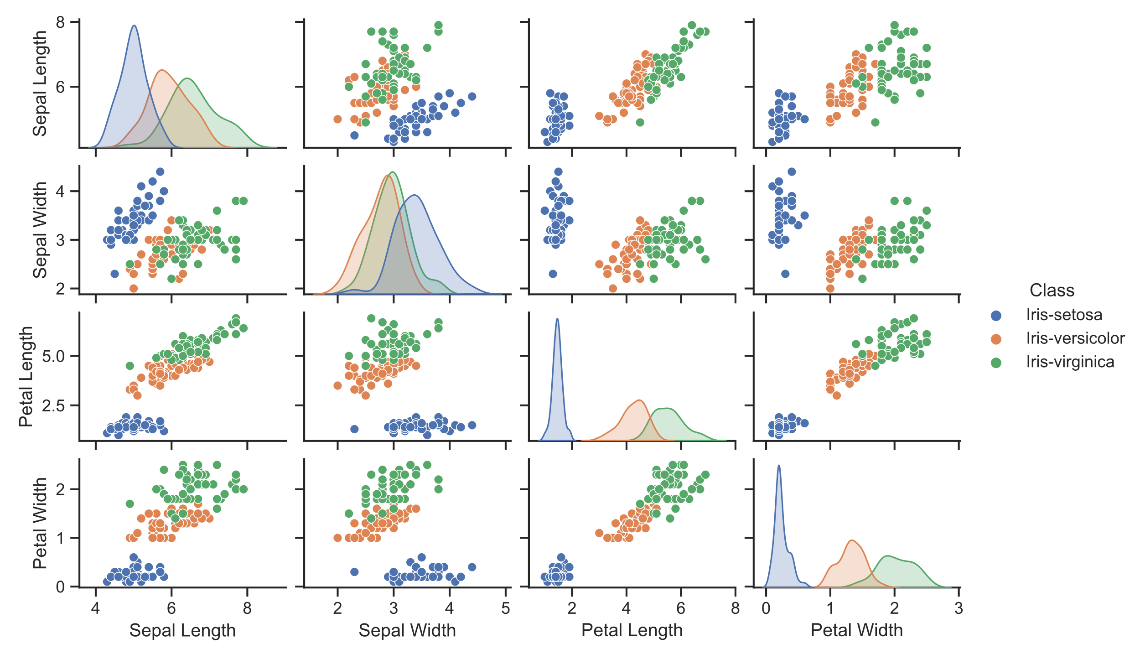
Classifying Irises
Fisher’s Irises
3 Classes
4 Variables
Sepal Length
Sepal Width
Petal Length
Petal Width
Let’s build some classifiers for these irises…

Slide 18
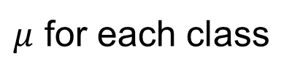
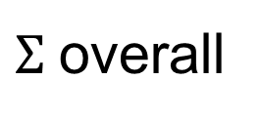
LDA - Irises
LDA specifies that each class of irises have unique vectors of means, but the same covariance matrix.
$Σ$overall
$μ$ for each class
 | Sepal Length | Sepal Width | Petal Length | Petal Width
Sepal Length | 0.686 | -0.039 | 1.274 | 0.517
Sepal Width | -0.039 | 0.188 | -0.322 | -0.118
Petal Length | 1.274 | -0.322 | 3.113 | 1.296
Petal Width | 0.517 | -0.118 | 1.296 | 0.582
Class | Sepal Length | Sepal Width | Petal Length | Petal Width
Iris-setosa | 5.006 | 3.418 | 1.464 | 0.244
Iris-versicolor | 5.936 | 2.77 | 4.26 | 1.326
Iris-virginica | 6.588 | 2.974 | 5.552 | 2.026

Slide 19
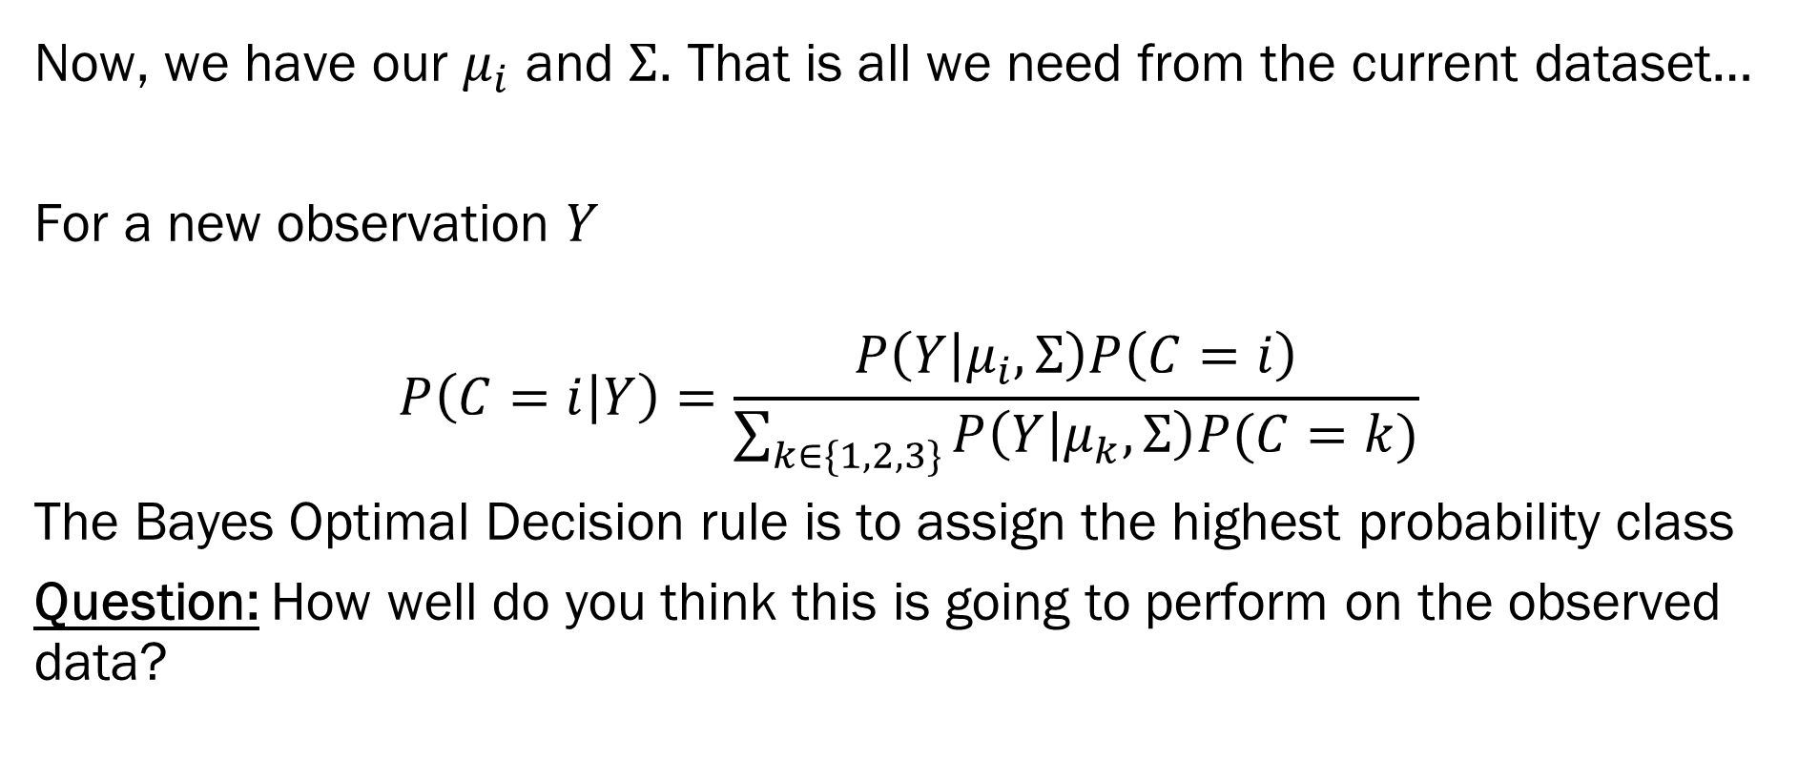
LDA - Irises
Now, we have our $μ_{i}$ and $Σ$. That is all we need from the current dataset…
For a new observation $Y$
$$P\left(C=i | Y\right)=\frac{P\left(Y | μ_{i}, Σ\right)P\left(C=i\right)}{\sum_{k∈\{1,2,3\}}{P\left(Y | μ_{k}, Σ\right)P(C=k)}}$$
The Bayes Optimal Decision rule is to assign the highest probability class
Question: How well do you think this is going to perform on the observed data?

Slide 20
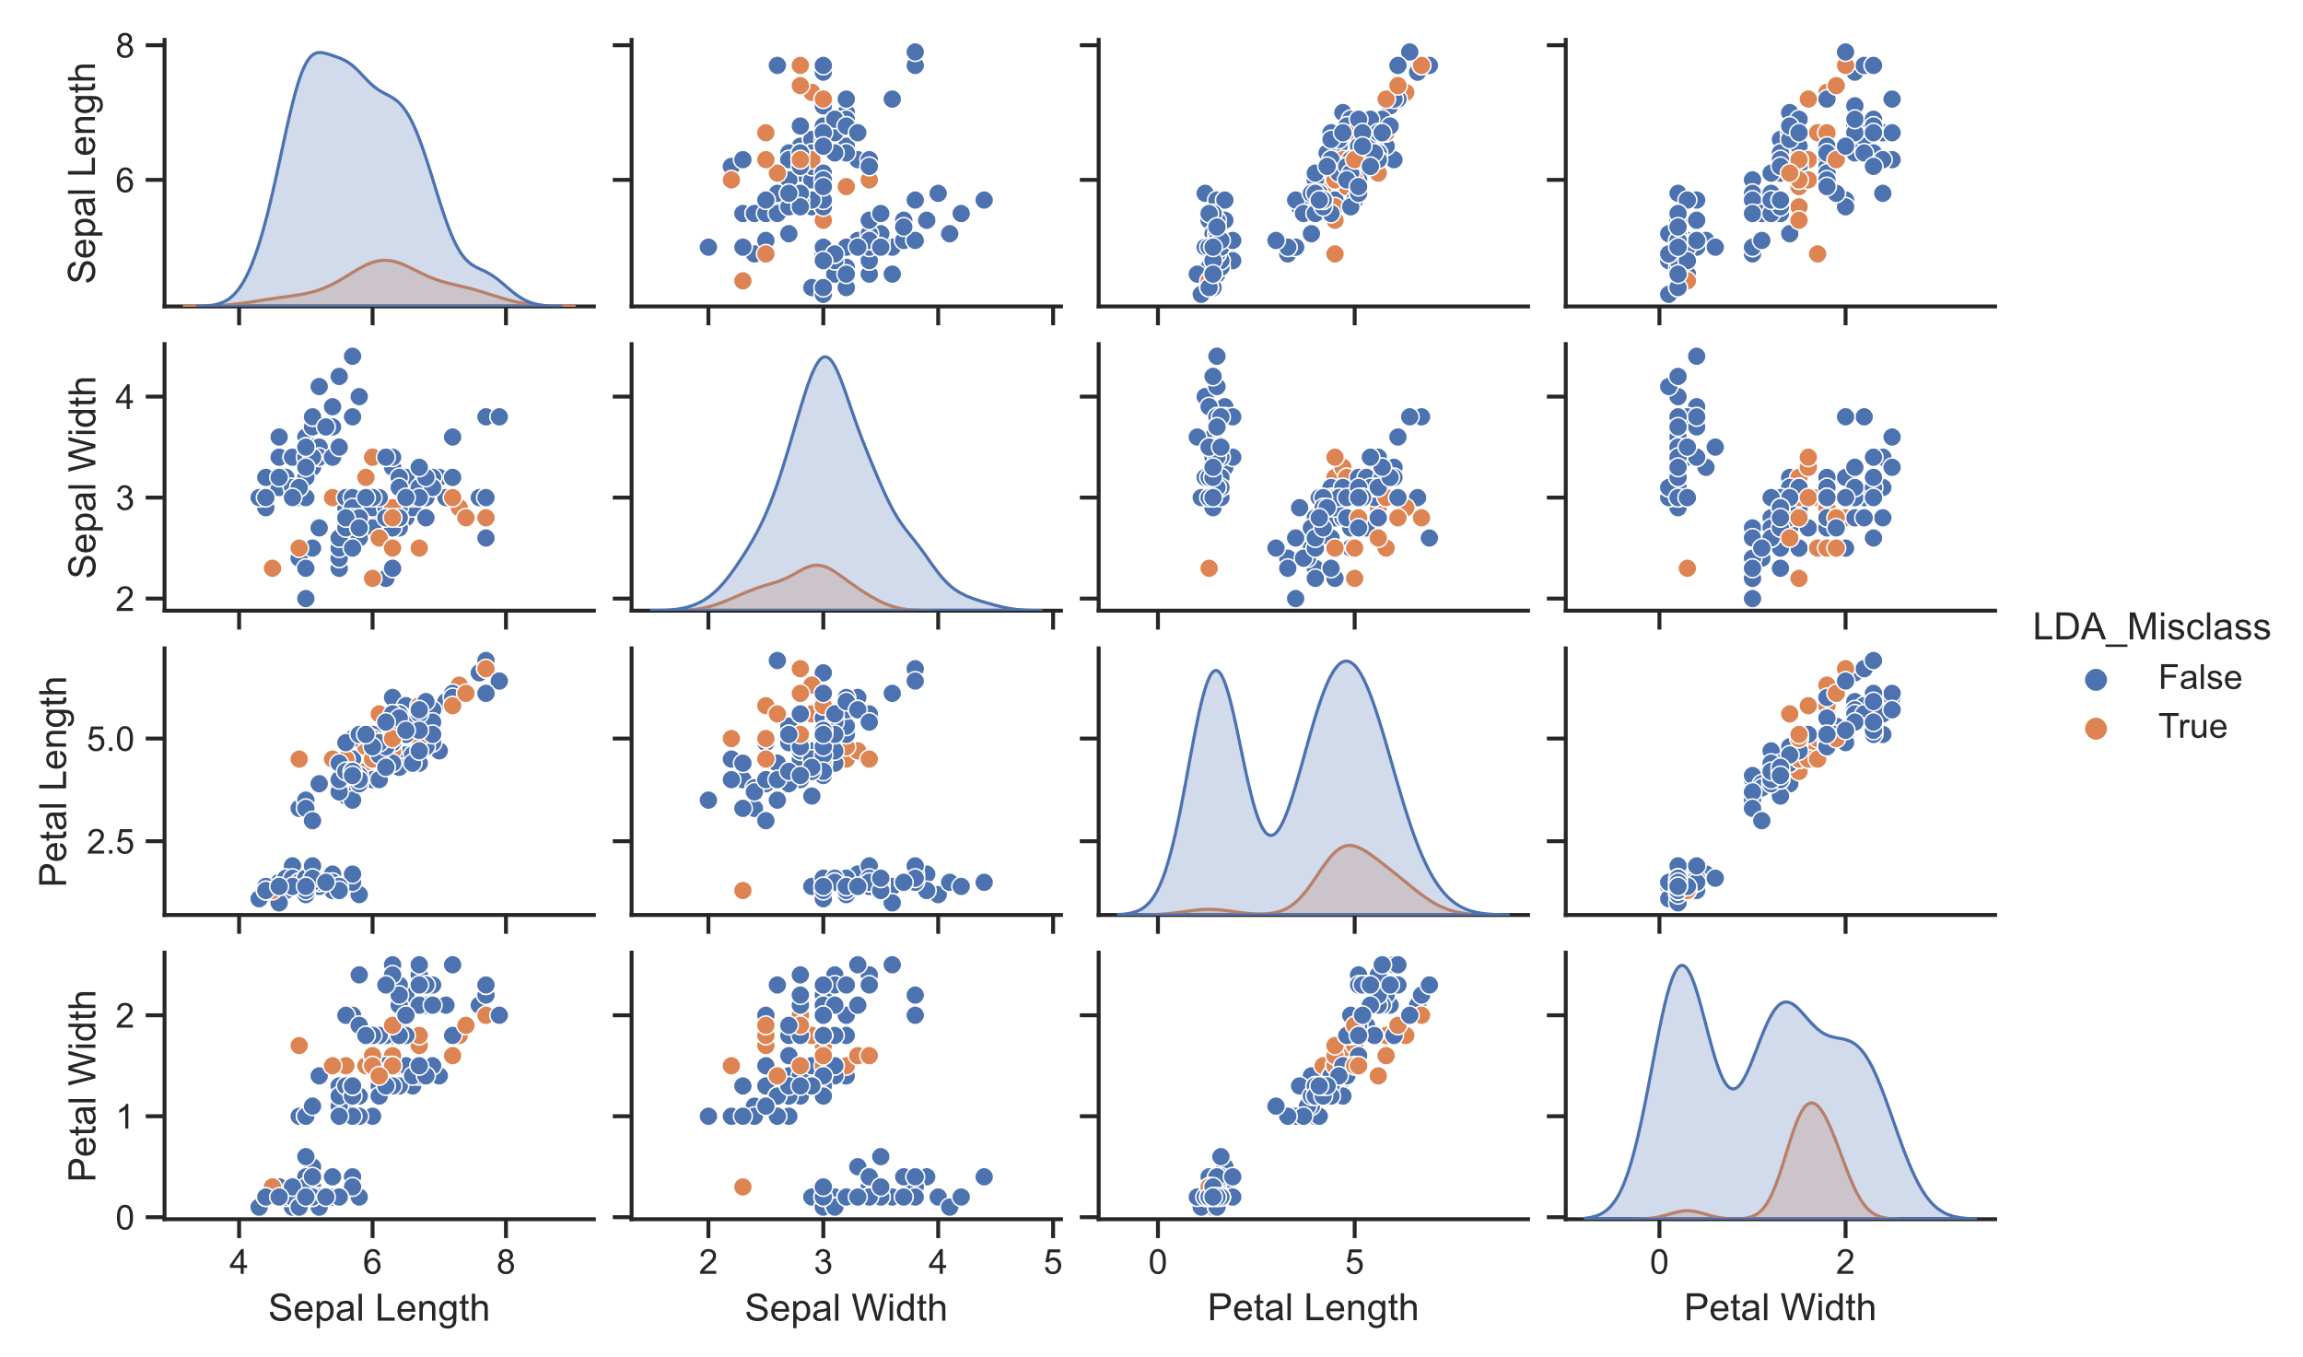
LDA - Irises
Overall Mis-Classification Rate of .13
LDA is struggling to correctly classify the versicolor and virginica classes…
 | LDA MAP Prediction | Iris-versicolor | Iris-virginica
Class | Iris-setosa | Iris-versicolor | Iris-virginica
Iris-setosa | 49 | 1 | 0
Iris-versicolor | 0 | 42 | 8
Iris-virginica | 0 | 11 | 39

Slide 21
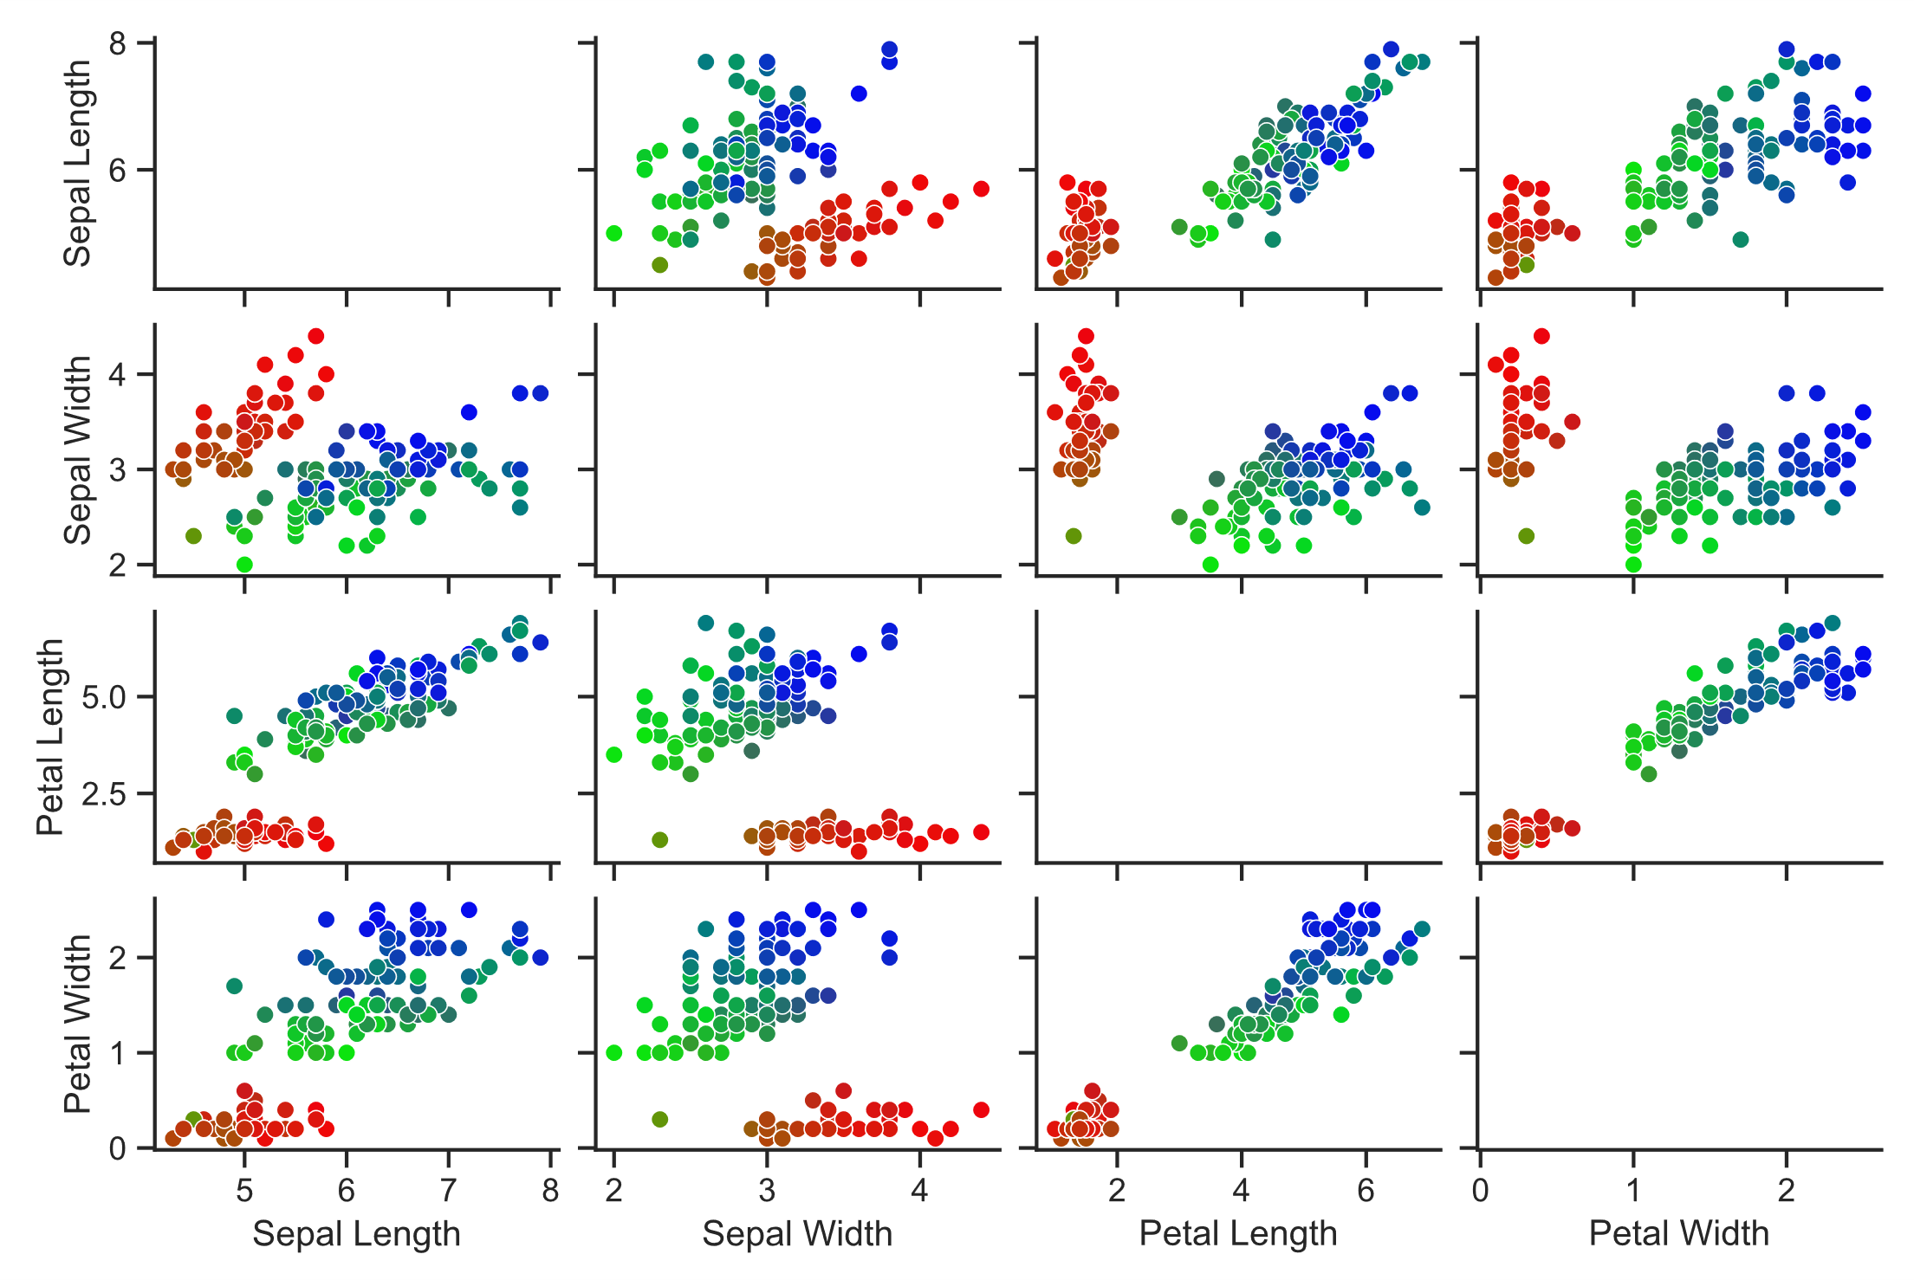
LDA - Irises
Probability Based Coloring
Red/Green/Blue assigned to the class probabilities.
Note the “fuzzy” boundaries between clusters. Those indicate poor discrimination between types.

Slide 22
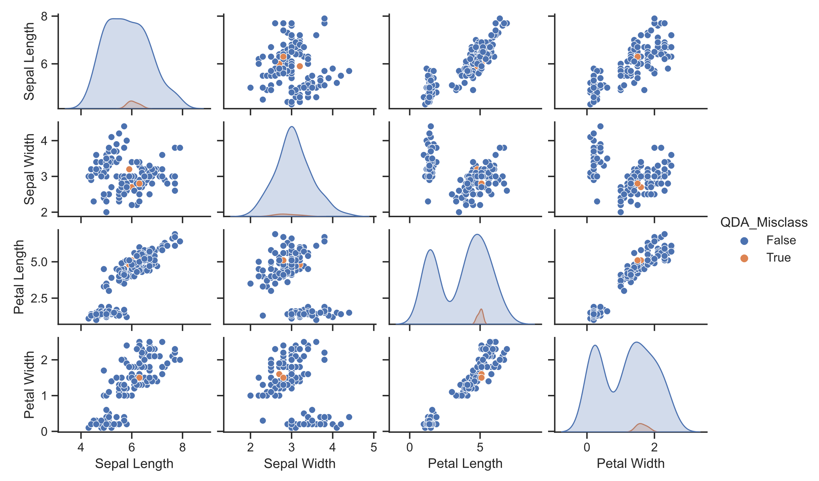
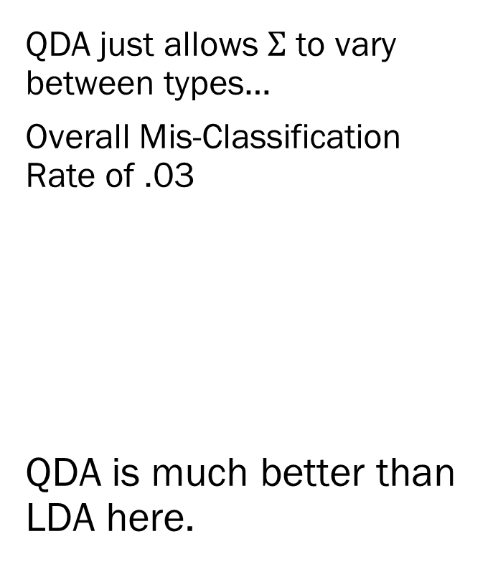
QDA - Irises
QDA just allows $Σ$ to vary between types…
Overall Mis-Classification Rate of .03
QDA is much better than LDA here.
 | QDA MAP Prediction | Iris-versicolor | Iris-virginica
Class | Iris-setosa | Iris-versicolor | Iris-virginica
Iris-setosa | 50 | 0 | 0
Iris-versicolor | 0 | 48 | 2
Iris-virginica | 0 | 1 | 49

Slide 23
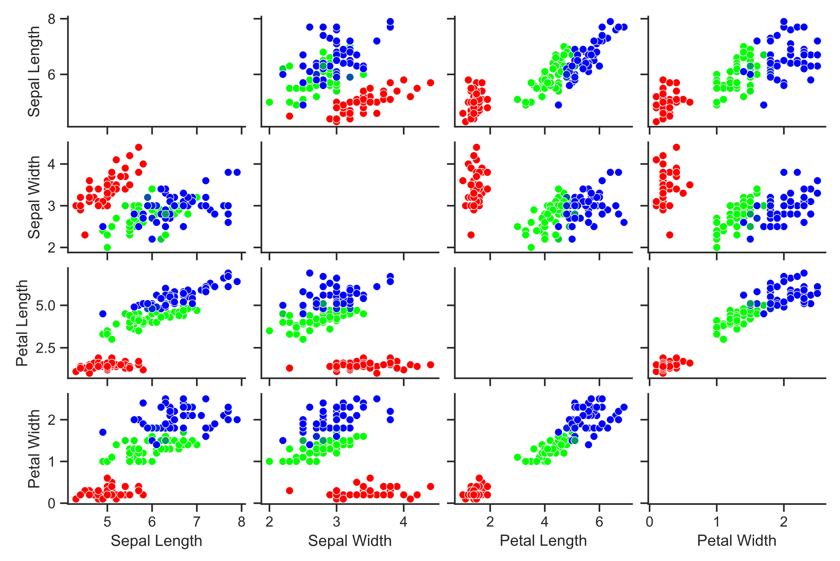
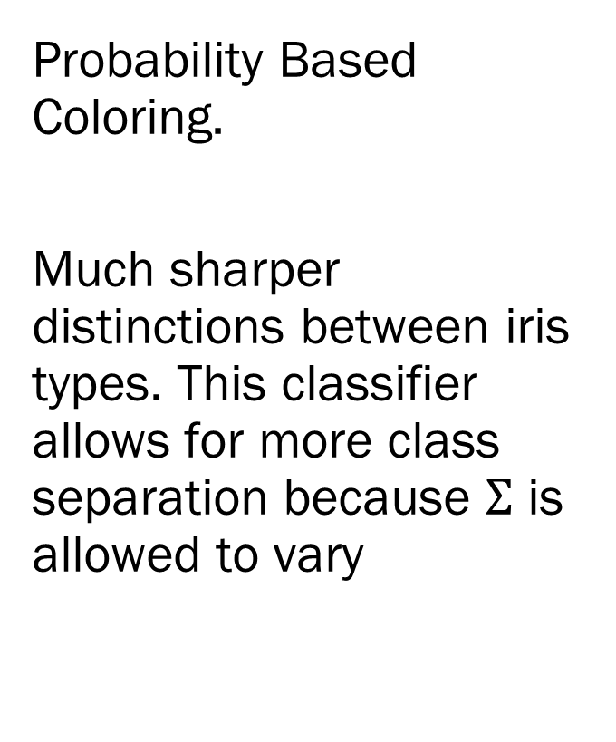
QDA - Irises
Probability Based Coloring.
Much sharper distinctions between iris types. This classifier allows for more class separation because $Σ$ is allowed to vary

Slide 24
Classification Overview
The general idea of classification is to obtain the probability of class membership and classify each observation with the most probable class.
The devil is in the details though…
How class is related to the distribution of the continuous predictors is the most important thing.
We saw that LDA, which assumes each group has the same covariance matrix performs much worse than QDA, which assumes a unique cov matrix for each group.
However, we might have issues with overfitting! Why should we believe that our sample estimates of group covariance matrices are correct?
We will address this issue later with hierarchical models.
Note: We did not address changing the prior distributions or the relative costs.

Slide 25
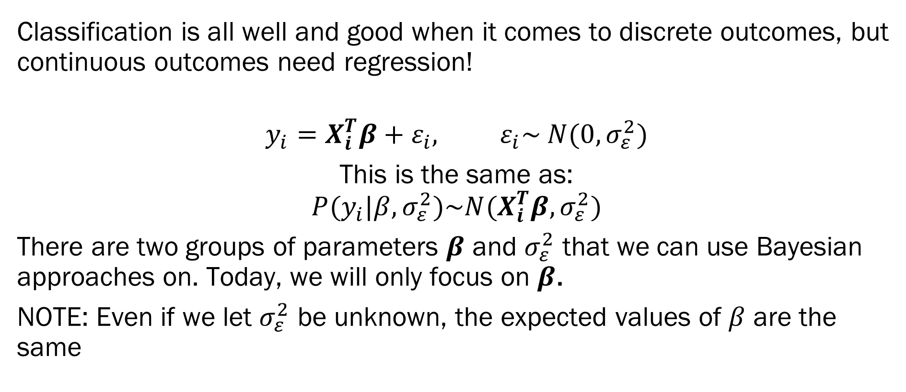
Bayesian Regression
Classification is all well and good when it comes to discrete outcomes, but continuous outcomes need regression!
$$y_{i}=X_{i}^{T}β+ε_{i}, ε_{i}\sim N(0, σ_{ε}^{2})$$
This is the same as:
$$P(y_{i}|β, σ_{ε}^{2})\sim N(X_{i}^{T}β, σ_{ε}^{2})$$
There are two groups of parameters $β$ and $σ_{ε}^{2}$ that we can use Bayesian approaches on. Today, we will only focus on $β$.
NOTE: Even if we let $σ_{ε}^{2}$ be unknown, the expected values of $β$ are the same
Likelihood

Slide 26
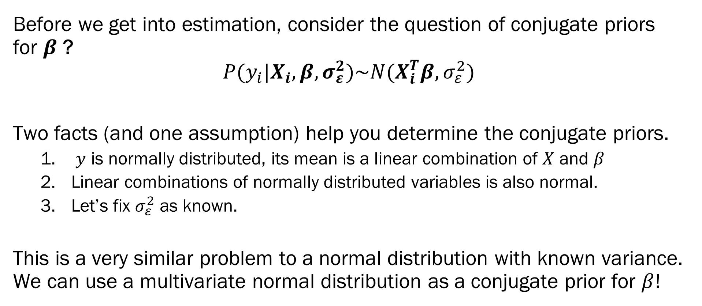
Bayesian Regression
Before we get into estimation, consider the question of conjugate priors for $β$ ?
$$P(y_{i}|X_{i},β,σ_{ε}^{2})\sim N(X_{i}^{T}β, σ_{ε}^{2})$$
Two facts (and one assumption) help you determine the conjugate priors.
$y$ is normally distributed, its mean is a linear combination of $X$ and $β$
Linear combinations of normally distributed variables is also normal.
Let’s fix $σ_{ε}^{2}$ as known.
This is a very similar problem to a normal distribution with known variance. We can use a multivariate normal distribution as a conjugate prior for $β!$

Slide 27
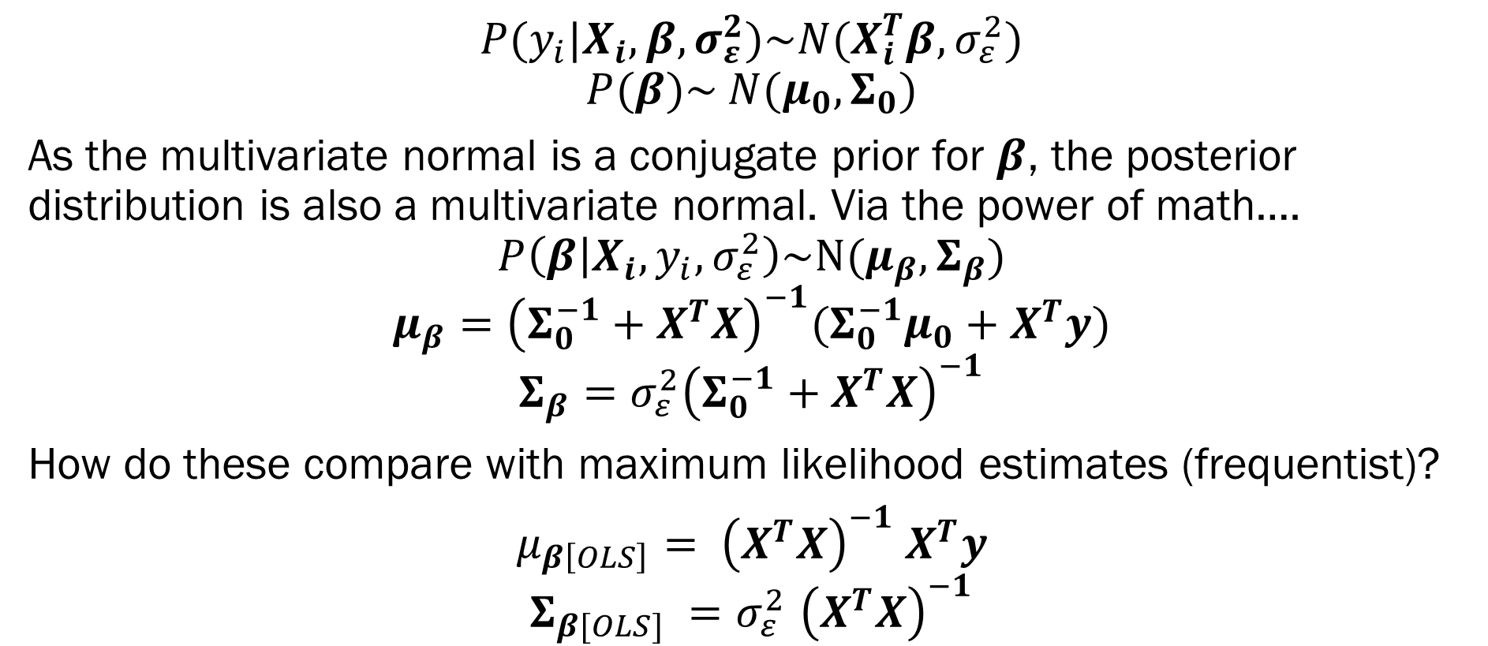
Bayesian Regression
$$P(y_{i}|X_{i},β,σ_{ε}^{2})\sim N(X_{i}^{T}β, σ_{ε}^{2})$$
$$P(β)\sim N(μ_{0}, Σ_{0})$$
As the multivariate normal is a conjugate prior for $β$, the posterior distribution is also a multivariate normal. Via the power of math….
$$P\left(β | X_{i}, y_{i},σ_{ε}^{2}\right)\sim N(μ_{β},Σ_{β})$$
$$μ_{β}={\left(Σ_{0}^{−1}+X^{T}X\right)}^{−1}(Σ_{0}^{−1}μ_{0}+X^{T}y)$$
$$Σ_{β}=σ_{ε}^{2}{\left(Σ_{0}^{−1}+X^{T}X\right)}^{−1}$$
How do these compare with maximum likelihood estimates (frequentist)?
$μ_{β\left[OLS\right]}= {\left(X^{T}X\right)}^{−1}$ $X^{T}y$
$$Σ_{β[OLS]} {=σ}_{ε}^{2}{\left(X^{T}X\right)}^{−1}$$
Likelihood!
Prior!
Posterior!

Slide 28
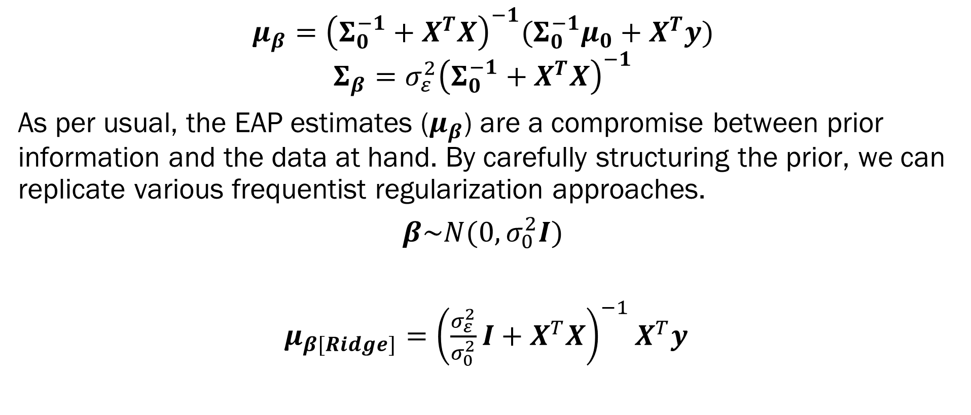
Bayesian Regression - Ridge
$$μ_{β}={\left(Σ_{0}^{−1}+X^{T}X\right)}^{−1}(Σ_{0}^{−1}μ_{0}+X^{T}y)$$
$$Σ_{β}=σ_{ε}^{2}{\left(Σ_{0}^{−1}+X^{T}X\right)}^{−1}$$
As per usual, the EAP estimates ($μ_{β}$) are a compromise between prior information and the data at hand. By carefully structuring the prior, we can replicate various frequentist regularization approaches.
$β\sim N(0, σ_{0}^{2}I)$
$μ_{β[Ridge]}={\left(\frac{σ_{ε}^{2}}{σ_{0}^{2}}I+X^{T}X\right)}^{−1}X^{T}y$

Slide 29
Red Wine Statistics
There is a famous dataset regarding wine quality as a function of various characteristics. (You will be looking at how to classify white wines in HW2).
Task: Predict alcohol content as a function of density and pH!

Slide 30
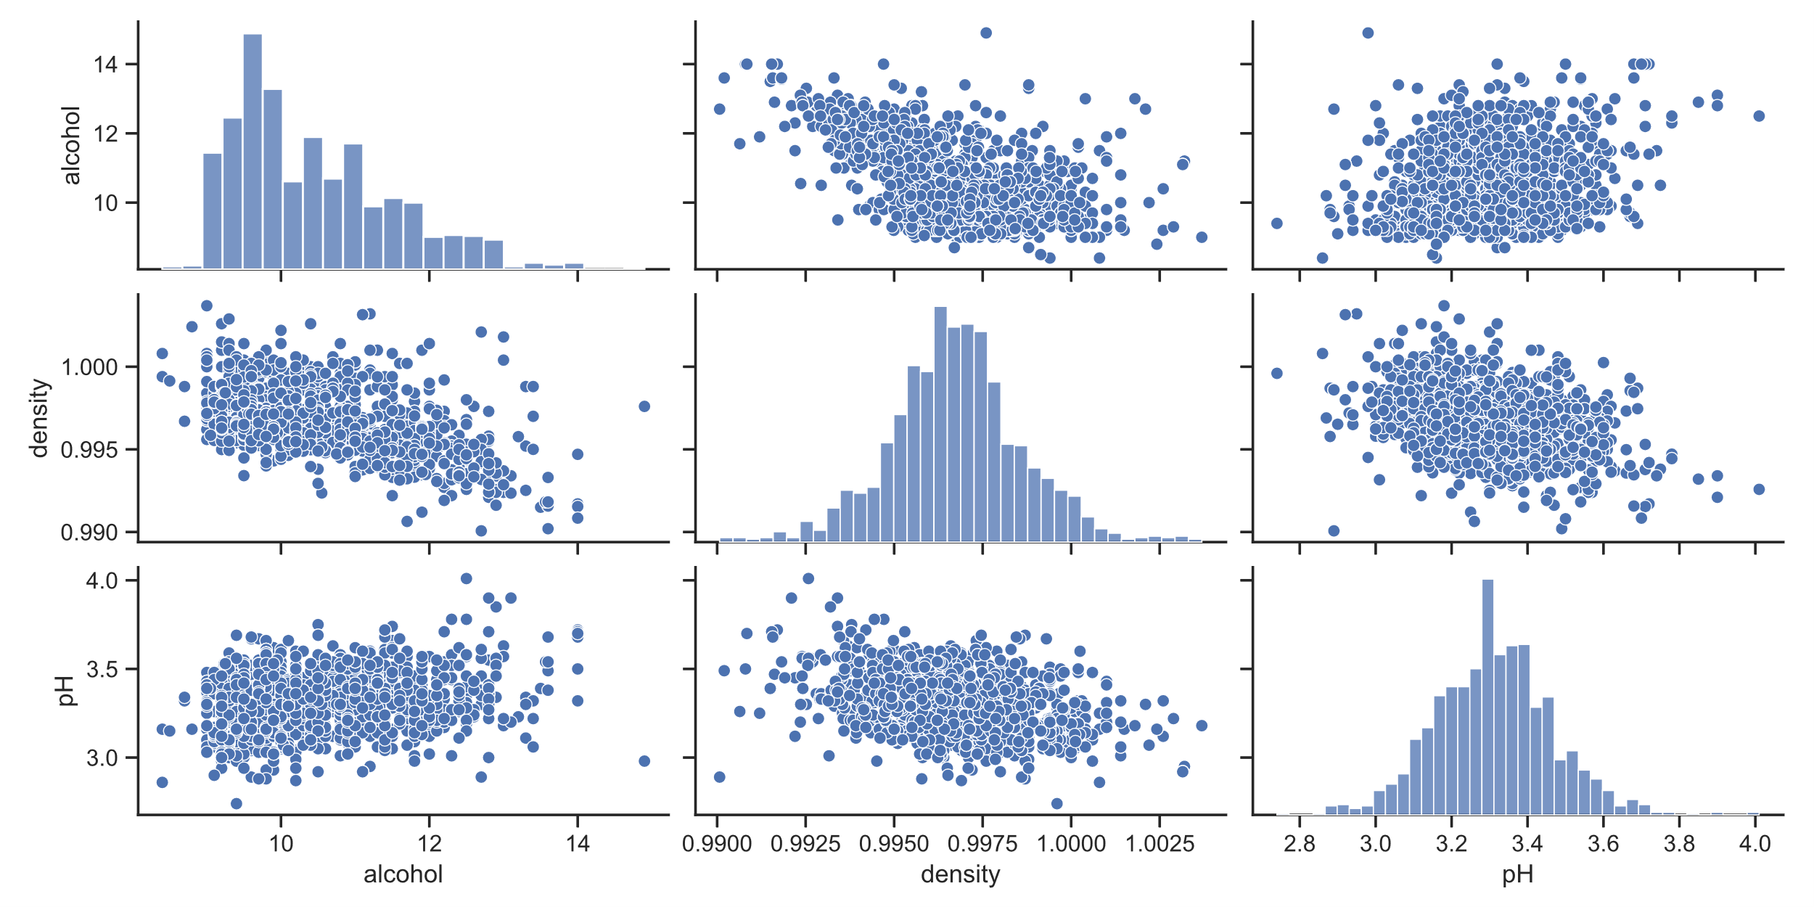
Red Wine Statistics

Slide 31
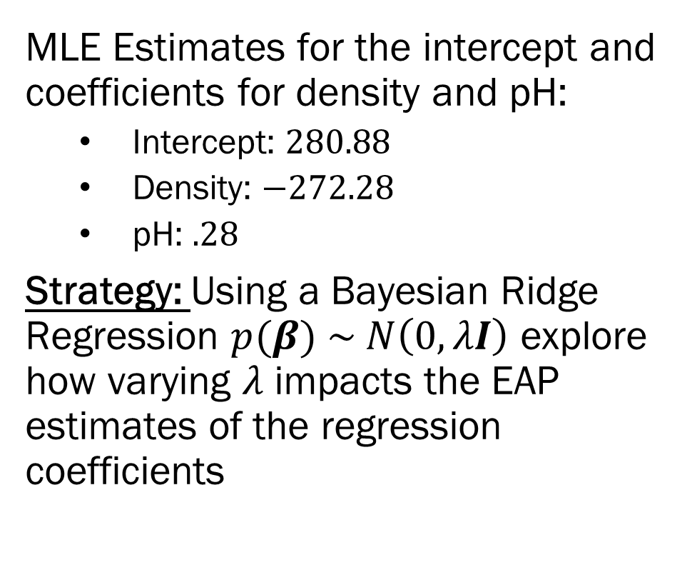
Red Wine Statistics
MLE Estimates for the intercept and coefficients for density and pH:
Intercept: $280.88$
Density: $−272.28$
pH: $.28$
Strategy: Using a Bayesian Ridge Regression $p(β) \sim N\left(0, λI\right)$ explore how varying $λ$ impacts the EAP estimates of the regression coefficients

Slide 32
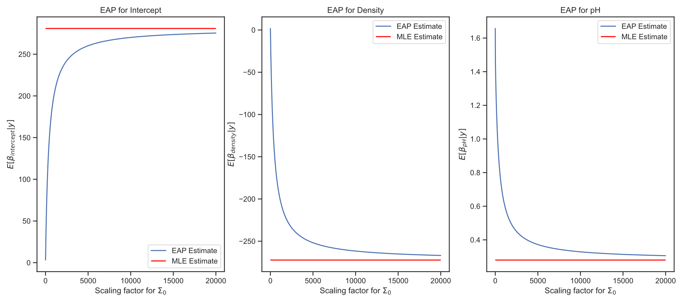
EAP Estimates

Slide 33
Summary + Next Steps
Jupyter Notebooks with Code for LDA, QDA and Bayesian Regression in Collab
Bayesian Classifiers –
Given a model for each class in your data, what is the most probable class for a new observation?
Currently, priors on class probability, NOT on aspects of class models.
Bayesian Regression –
Coefficients are compromises between prior and MLE estimates
Scaling matters!
Homework 2 –
Apply LDA and QDA to building predictors of wine quality
Next Week –
Representing Bayesian models using networks!

